Slide 1

AdSmart A/B Testing
Kenney Kwan
October 27, 2021

Slide 2
Why?
A/B testing is, at its most basic, a way to compare two versions of something to figure out which performs better. This method of testing has been around for a long time and is an intuitive way to compare similar things. Its no wonder that A/B testing is still an important testing method used by businesses today to look at any number of metrics (eg. customer engagement, web traffic, revenue) and see which version increases performance.
AdSmart is looking to increase customer engagement with their questionnaire. They have recorded the data on users that have seen a dummy ad and users that have seen the new ad. Which version of their ad performs better?

Slide 3
Datasets
AdSmartABdata – A dataset from a company running an A/B test on a new advertisement to increase customer engagement with their questionnaire.

Slide 4
The data was mostly clean already. There were no null values, and a couple of columns needed to be adjusted.
The date and hour column were converted to datetime and merged into 1 column
The yes and no column merged into a success column and no response column was added
Data Wrangling

Slide 5
EDA
The Success column tracks if the user clicked on yes on the questionnaire at the end of the ad. No response tracks if the user did not respond to the questionnaire. The combination of these metrics shows every possible combination of user engagement.
if success is 0 and no response is 0 - user clicked on no after the ad
if success is 1 and no response is 0 - user clicked on yes after the ad
if success is 0 and no response is 1 - user neither clicked on yes or no
if success is 1 and no response is 1 - not possible in our implementation.

Slide 6
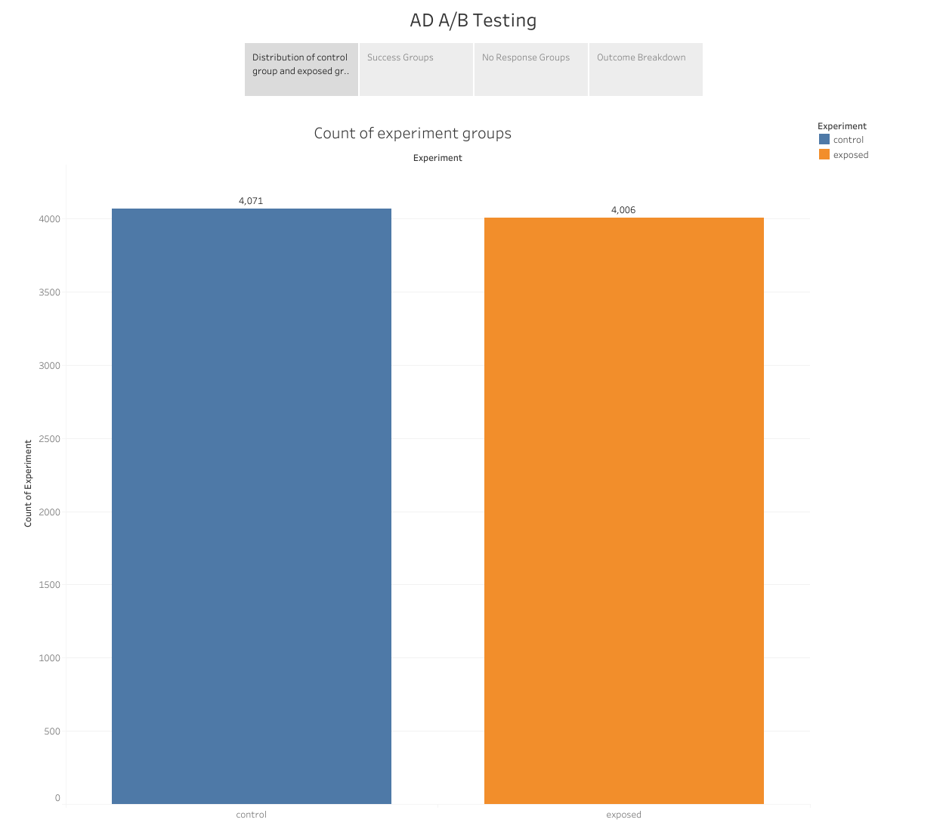
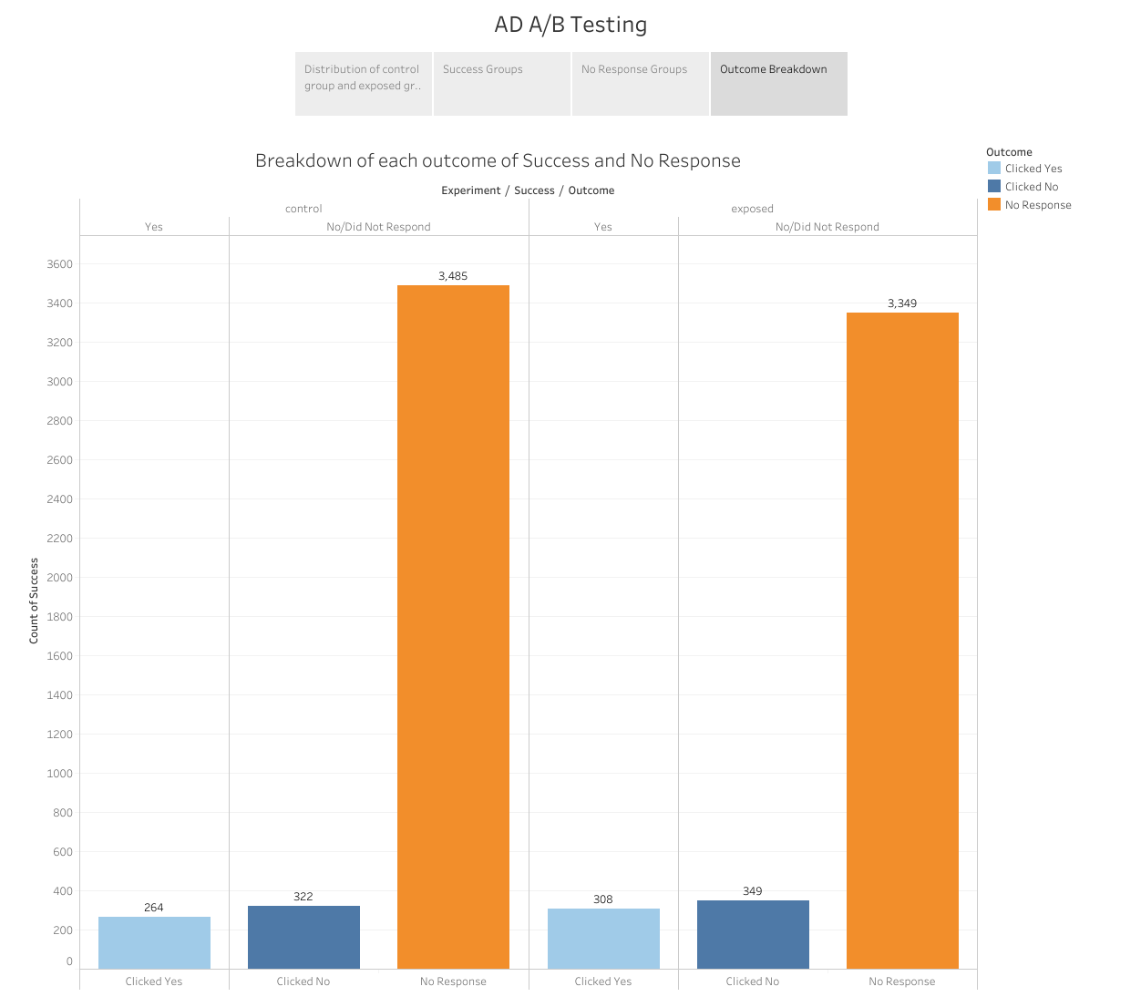
EDA

Slide 7
Modeling Z Test
What is the correct measure for ad success? Here we looked at three different scenarios that AdSmart could use to measure ad success.
How does our new ad perform when looking at the yes responses vs no/no response?
How does our ad perform when looking at just the yes responses vs no responses?
How does our ad perform when looking at those that did not respond vs responded?
Z test was performed as the sample size of my data was large enough that the distribution was roughly normal

Slide 8
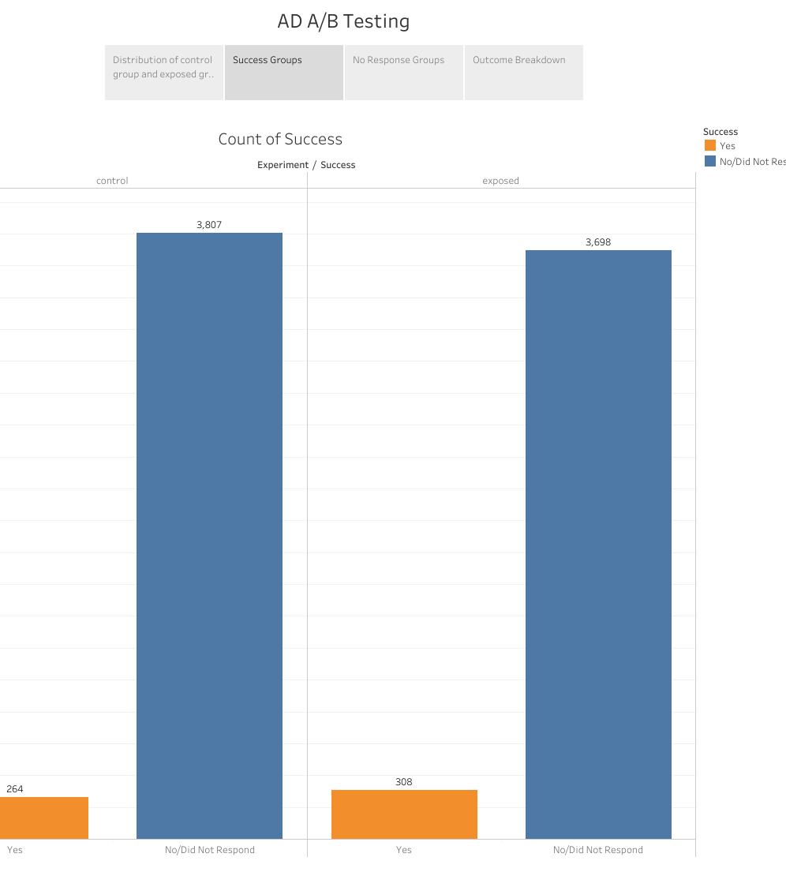
Modeling Yes vs no/no response
Null hypothesis: There is no significant difference between the ad success rate of both groups
Alt hypothesis: There is significant difference between the ad success of both groups
P value: 0.035
Since the p value is less than 0.05, then we reject the null hypothesis. There is a significant difference in ad success between the control group and the exposed group.
The exposed group were more likely to click yes after viewing the new ad. The ad success rate of the control group was found to be 6.48% and the exposed group to be 7.69%

Slide 9
Modeling Yes vs No
Null hypothesis: There is no significant difference between the questionnaire engagement rate of both groups
Alt hypothesis: There is significant difference between the questionnaire engagement rate of both groups
P value: 0.052
Since the p value is greater than 0.05, then we fail to reject the null hypothesis. There is no significant difference in questionnaire engagement between the control group and the exposed group.
When filtering out the no response answers. The proportion of users that clicked on yes or no is about the same in both groups.

Slide 10
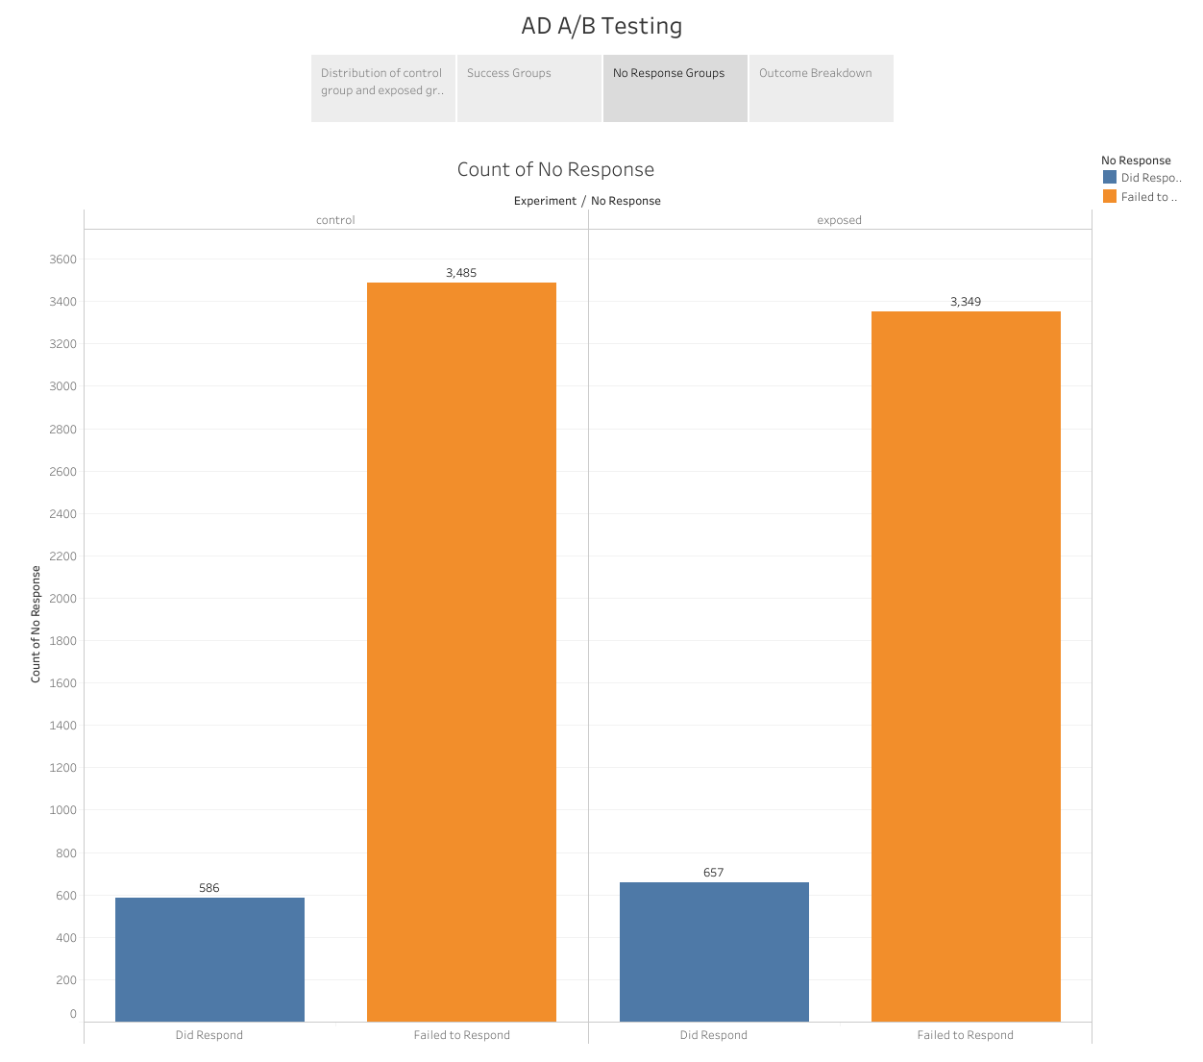
Modeling No response vs Response
Null hypothesis: There is no significant difference between ad disengagement rate between groups
Alt hypothesis: There is significant difference between ad disengagement rate between groups
P value: 0.012
Since the p value is less than 0.05, then we reject the null hypothesis. There is a significant difference in questionnaire disengagement rate in the control group and the exposed group.
The exposed group were less likely to click away from the ad and answer yes or no at the end of the ad. The new ad has a better response rate from users and could also mean that it is better at converting customers into a response, either yes or no.

Slide 11
P Value Table
Test | P Value | Results
Yes vs No/No response | 0.035006 | Reject the null hypothesis. There is a significant difference in ad success between the control group and the exposed group
Yes vs No | 0.518486 | Fail to reject the null hypothesis. There is no significant difference in questionnaire engagement between the control group and the exposed group.
No response vs Response | 0.012495 | Reject the null hypothesis. There is a significant difference in questionnaire disengagement between the control group and the exposed group.

Slide 12
Insights
When looking at the different statistical models, I ran the model on different metrics of 'success'
The test for yes vs no/response shows the new ad had an improved impact on customers engaging in the questionnaire
The data shows the ad success rate of the control group to be 6.48% and the exposed group to be 7.69%
The test for no response rate shows the exposed group has a lower rate of no response compared to the control group.
The data shows the ad no response rate of the control group to be 85.61% and the exposed group to be 83.60%
That would mean that the new ad not only performs better on all customers, but is also better at converting customers that normally would not respond

Slide 13
Recommendations
The data suggests that when looking at yes responses vs no/no response and no response rate, the new ad has more people engaging with the questionnaire.
First recommendation – the data suggests the business use the new ad as it has shown to increase ad success and higher customer engagement
When looking at the data of yes responses vs no responses, there was no significant difference between groups.

Slide 14
Recommendations
Second recommendation – the data suggests that the business should keep with the old ad, if it is only concerned about the customers that stayed to the end of the ad. However, I would personally steer away from the old ad shown in the other two tests that more people respond to the new ad, and less people click away while in the middle of the ad
When looking at the data of no response vs response data, the new ad had a lower disengagement rate
Third recommendation – the data suggests that the business use the new ad as on average the no response rate of the control group to be 85.61% and the exposed group to be 83.60%. The new ad can reach a wider audience with the higher engagement rate

Slide 15
Further Research
This experiment looked at how many people answered AdSmart’s questionnaire. Further A/B testing and experimentation could be done to see if the new ad translated to more revenue for the company.
Further research could also be done on expanding the data that is gathered on users, such as gender or locational data. The new ad could be further refined to target which platform users accessed the Ad from. All of these factors would help AdSmart target specific audiences more efficiently.

